Slide 1
COMP 3647 Human-AI Interaction Design Topic 12: Prototyping Prof. Effie L-C Law

Slide 2


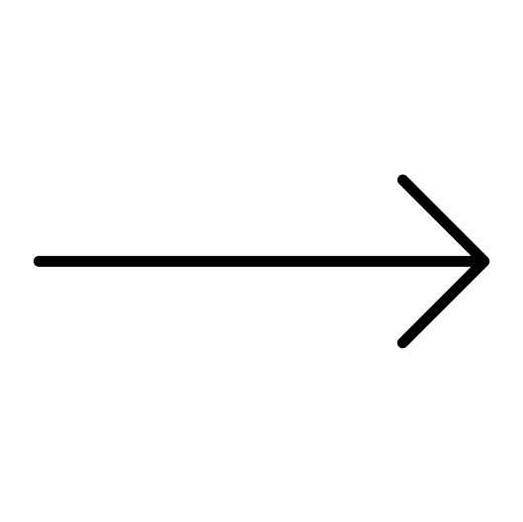
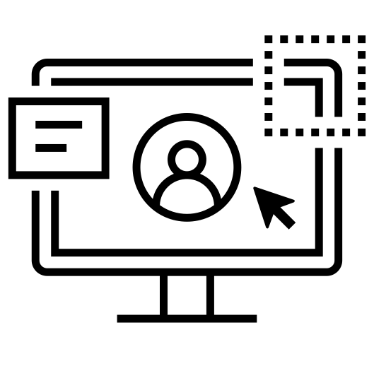
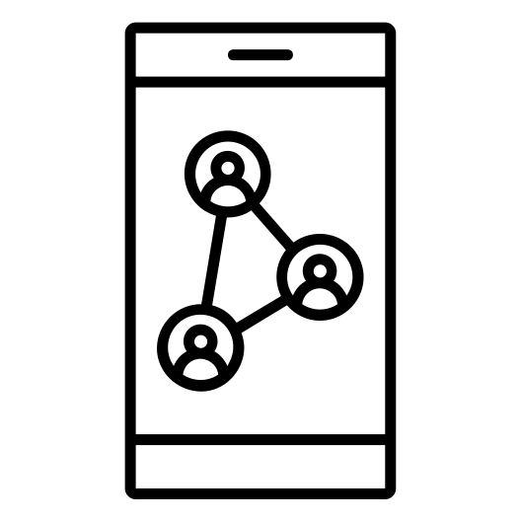

An exciting new project
Months…
Brainstorming, planning… Building, crafting… Perfection… Everything right…
Having sweated and spent valuable time, money, and recourses; attracting visitors… BUT, no customers.

Slide 3
What went wrong?
An exciting new project
Ideas being executed with an obsession for making a dent in the market, making big changes in society or just completely re-inventing the wheel, only to realise right at the end of their journey that they’ve been wasting time or focussing on the wrong thing.
Here comes prototyping.
To provide a set of tools and approaches for properly testing and exploring ideas before too many recourses get used.

Slide 4
Prototype

Slide 5
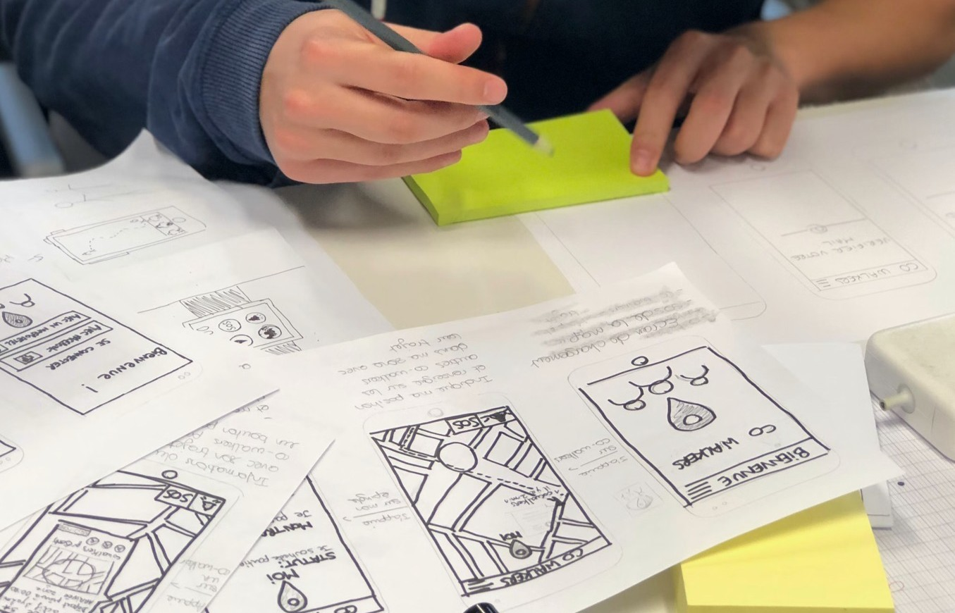

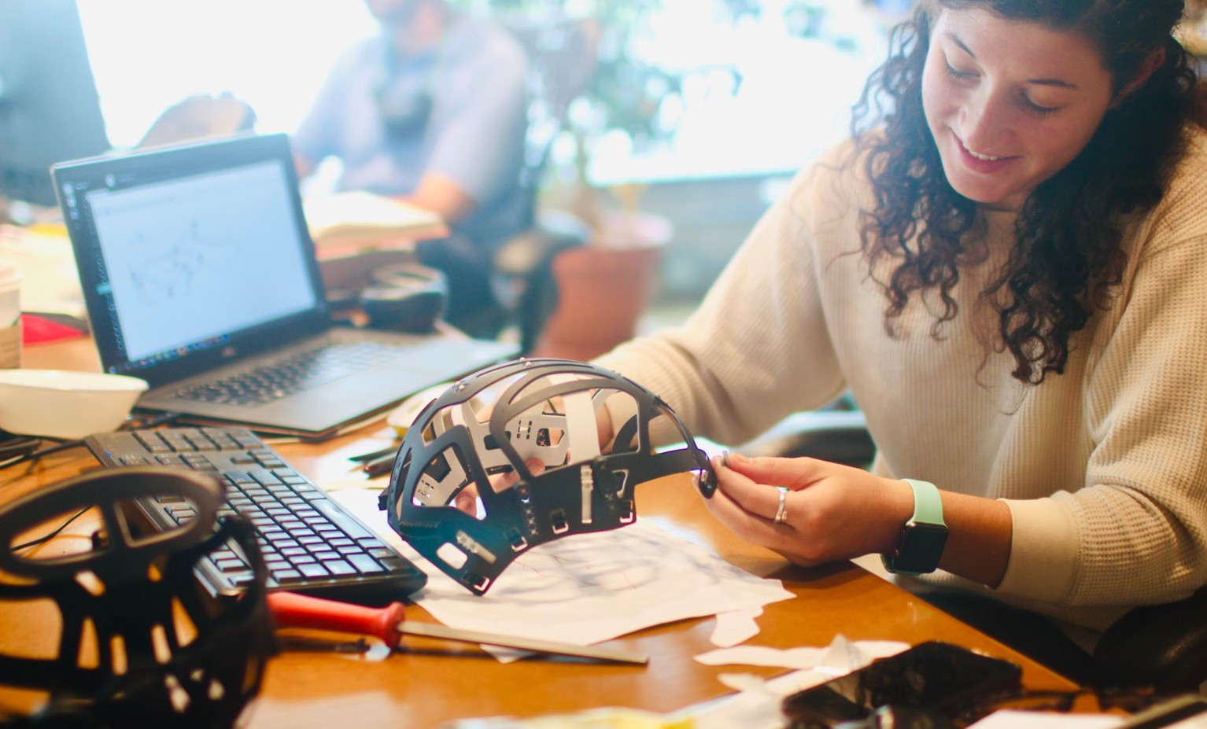

Prototype
“An early sample, model, or release of a product built to test a concept or process.” An expression of design intent.
To present designers’ designs and see them in action.
To show intention behind a feature or overall design concept to users
A simulation of the final interaction between users and the interface (digital product).
Simulations of the entire app or just a single interaction.
Can be paper drawings, wireframes, mock-ups, web-based.

Slide 6
Prototype
Main qualities:
Representation
Evolution
Precision
Interactivity

Slide 7
Prototype
Representation
The prototype itself, i.e., paper & mobile, or HTML & desktop.
Precision
The fidelity of the prototype, i.e., its level of details: low- or high- fidelity.
Interactivity
The functionality open to the user, e.g., fully or partially functional, or view-only.
Evolution
The lifecycle of the prototype. Some are built quickly, tested, thrown away, and then replaced with an improved version (a.k.a. “rapid prototyping”). Others may be created and improved upon, ultimately evolving the final product.

Slide 8
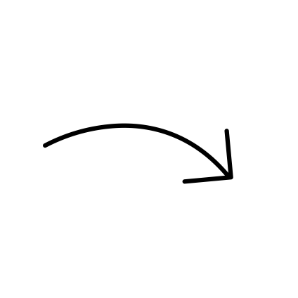
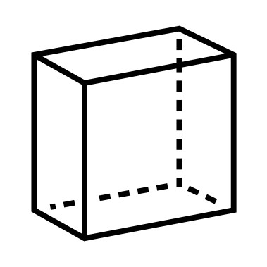


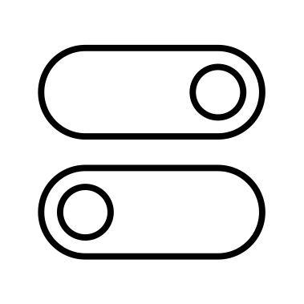

Prototype
It only needs to be done once or twice at the end of the design process. NOT TRUE!
You should prototype every possible iteration of your design – even early basic ideas.
prototype
review
refine

Slide 9
Prototype
Testable Prototype
A hypothesis / candidate design solution for a specific design problem.
How to test the hypothesis?
The most straightforward way is to watch users work with it.
Different types of prototypes, ranging between any of these pairs of extremes:
single page realistic & detailed
interactive
multipage
hand-sketched on a piece of paper static
Choice of prototype vary depending on goals of testing, completeness of design, tools used to create the prototype, resources available to help before & during test.

Slide 10
Prototype
Interactive vs Static Prototypes
Work needs to be done to bring a prototype to life for usability testing.
To make it respond to user actions
we spend time implementing interactions before test, or we “fake” interaction during test.
Interactive prototype
Static prototype
Clickable, time-consuming… Designer must set a response for each possible user action before test happens.
Responses to user actions are given in real-time during the test by a person who is familiar with the design.

Slide 11



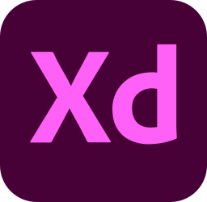

Prototype
Interactive vs Static Prototypes
Interactive prototype
Several tools (desktop- & web- based)
…

Slide 12
https://www.youtube.com/c/Figmadesign/playlists https://www.figma.com/education/

Slide 13
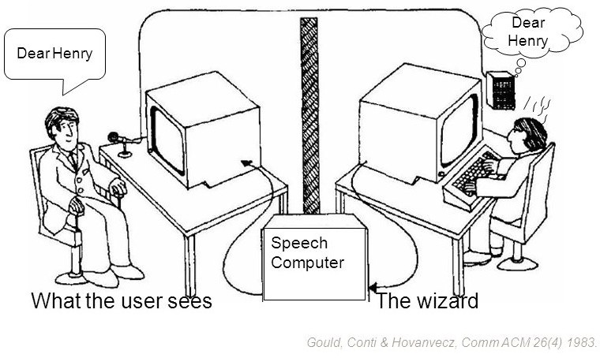
Prototype
Interactive vs Static Prototypes
Static prototype
Several methods
Wizard of Oz

Slide 14
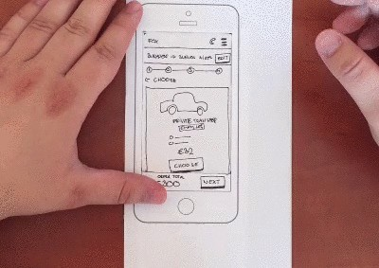
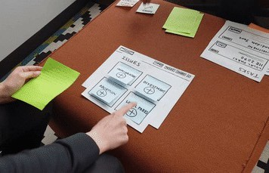
Prototype
Interactive vs Static Prototypes
Static prototype
Several methods
Paper-Prototype “Computer”
Simulate scrolling by pulling a long strip of content through the viewport. Image: Csaba Házi
Image: gfycat

Slide 15
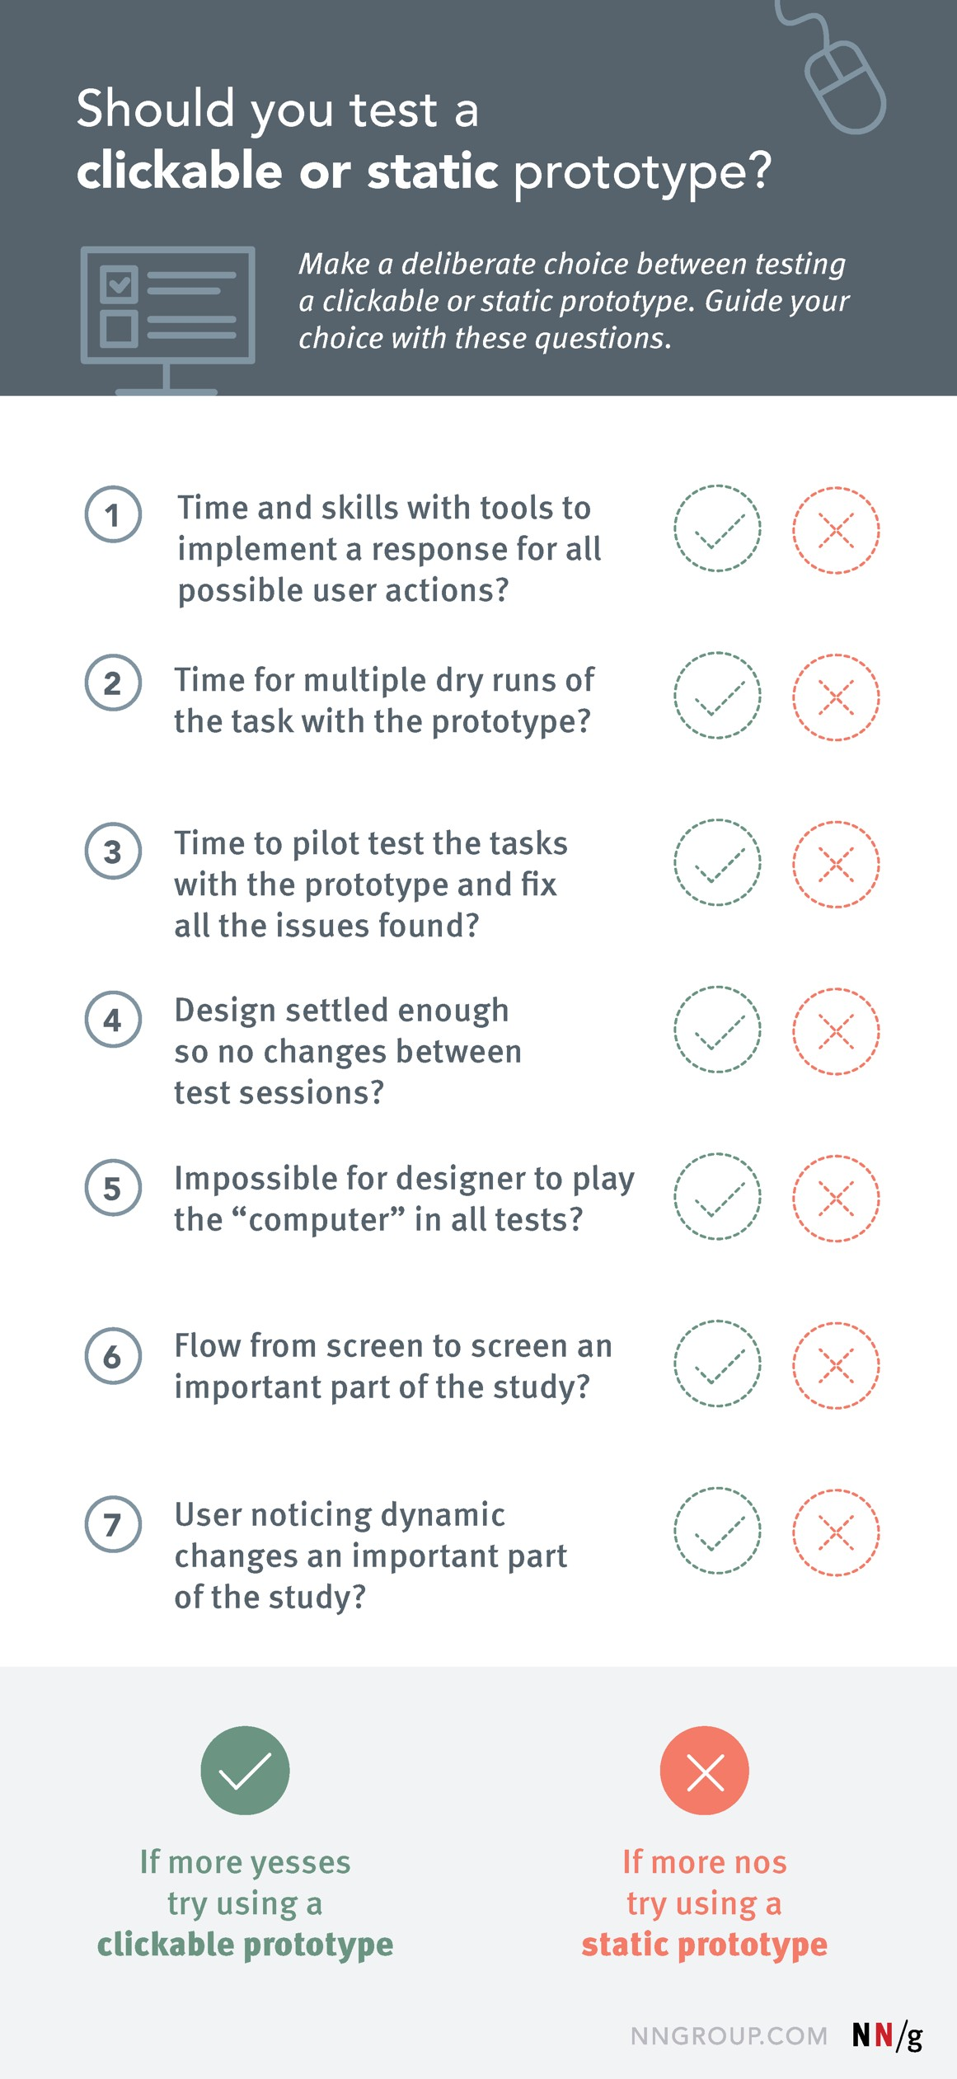
Prototype
Interactive vs Static Prototypes
Criteria to help you decide which type of prototype is right for your project:

Slide 16
Fidelity

Slide 17
Fidelity
How closely a prototype matches the look-and-feel of the final system.
Can vary in the areas of:
Visuals
Content
Interactivity
May have high / low fidelity in all or some of the above 3 areas.

Slide 18
Fidelity
Low-fidelity (lo-fi) prototyping
A quick and easy way to translate high-level design concepts into tangible and testable artifacts. The first and most important role of lo-fi prototypes is to check and test functionality rather than the visual appearance of the product.
Basic characteristics
Visuals: only some of the visual attributes of the final system are presented
Content: only key elements of the content are included.
Interactivity: the prototype can be simulated by real human during testing session, a particular person who is familiar with design acts as a computer and manually changes the design’s state in real-time.

Slide 19
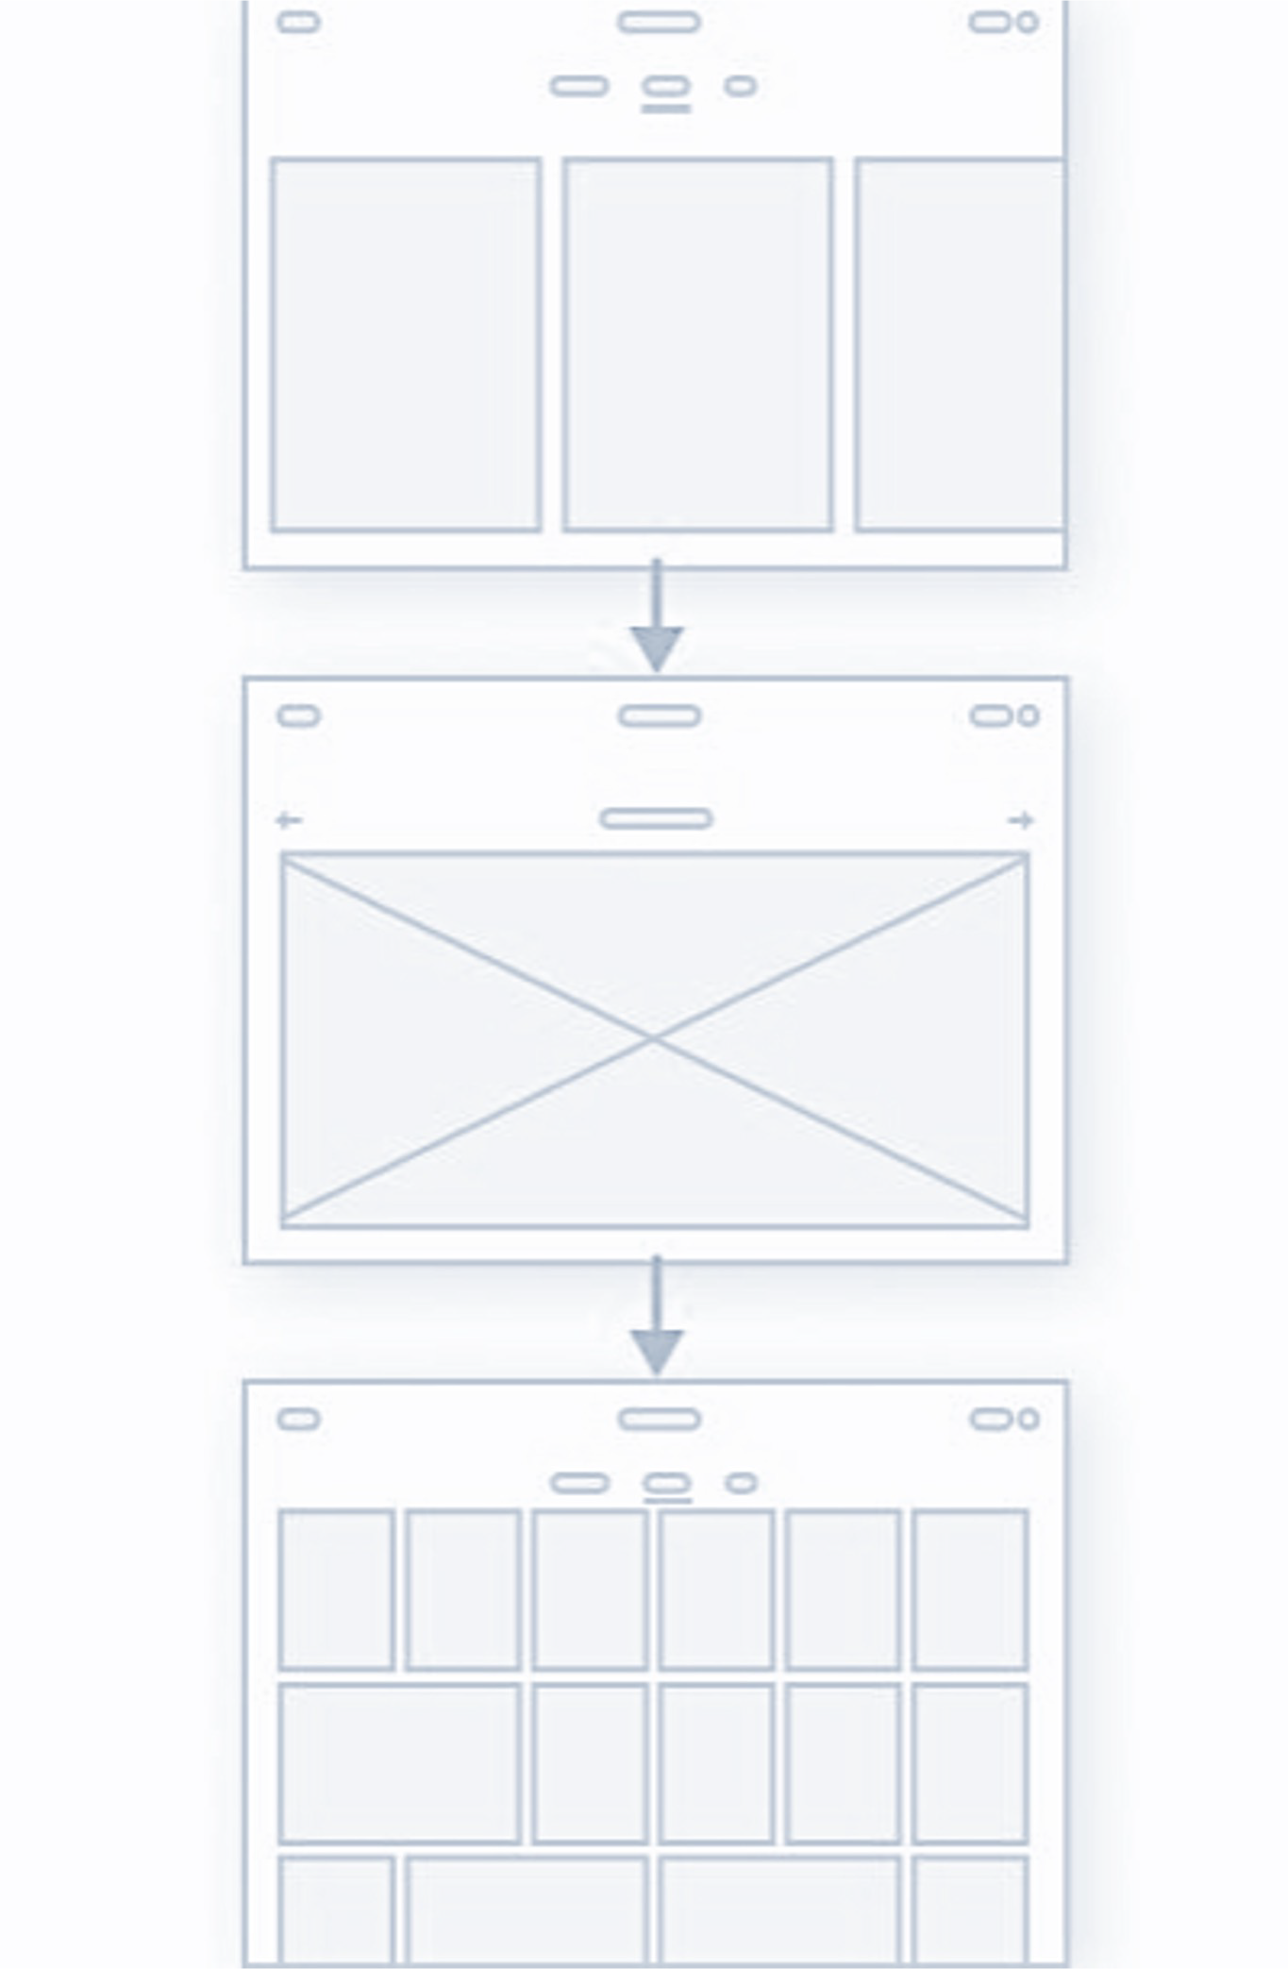
Fidelity
Low-fidelity (lo-fi) prototyping
Pros
Inexpensive
Fast
Collaborative
Clarifying
Cons
Uncertainty during testing
Limited interactivity

Slide 20
Fidelity
High-fidelity (hi-fi) prototyping
Appear & function as similar as possible to actual system that will ship. Teams usually create high-fidelity prototypes when they have a solid understanding of what they are going to build and they need to either test it with real users or get final-design approval from stakeholders.
Basic characteristics
Visuals: realistic & detailed design
Content: most or all of the content that will appear in the final design.
Interactivity: highly realistic in their interactions.

Slide 21

Fidelity
High-fidelity (hi-fi) prototyping
Pros
Meaningful feedback during usability testing
Testability of specific UI elements or interactions
Easy buy-in from clients and stakeholders
Cons
Higher costs

Slide 22
Steps

Slide 23
Steps
How to get started with prototyping
1
2
3
4
5
6
Ask key questions first
Start with the visual side of things
Choose the right kind of prototype
Turn sketches into lo-fi prototypes
Transition from lo-fi to hi-fi prototypes
Move from hi-fi prototypes into code

Slide 24
Steps: 1st
How to get started with prototyping
1
2
3
4
5
6
Ask key questions first
Start with the visual side of things
Choose the right kind of prototype
Turn sketches into lo-fi prototypes
Transition from lo-fi to hi-fi prototypes
Move from hi-fi prototypes into code
What problem, need, or discovery am I looking to address?
What is the end goal for the prototype? What are its values and functions?
Who is the target audience? Are you trying to solve problems for certain users? Who are these users, and what are their specific problems?
What are the desired final deliverables?
How much time do I have to allocate to this prototype?

Slide 25
Steps: 2nd
How to get started with prototyping
1
2
3
4
5
6
Ask key questions first
Start with the visual side of things
Choose the right kind of prototype
Turn sketches into lo-fi prototypes
Transition from lo-fi to hi-fi prototypes
Move from hi-fi prototypes into code
User flow – how users achieve their goals by interacting with the system.
Info entities – how input/output in user flow relate to user behaviour & expectations.
First sketches – sketch out user flow (focus on functionality).
Rudimentary structure – layout content (text, photos, video, etc.) as basic boxes.

Slide 26
Steps: 3rd
How to get started with prototyping
1
2
3
4
5
6
Ask key questions first
Start with the visual side of things
Choose the right kind of prototype
Turn sketches into lo-fi prototypes
Transition from lo-fi to hi-fi prototypes
Move from hi-fi prototypes into code
Before creating a prototype, consider key goals and the time & resources available.
Lo-fi prototypes make sense in early stages, but you will want to move on to hi-fi prototypes as you get closer to the final product.

Slide 27
Steps: 4th
How to get started with prototyping
1
2
3
4
5
6
Ask key questions first
Start with the visual side of things
Choose the right kind of prototype
Turn sketches into lo-fi prototypes
Transition from lo-fi to hi-fi prototypes
Move from hi-fi prototypes into code
The focus should no longer be on creatively adding all necessary elements – instead, it should be on effectively organising the structure of the designs and the assets they include.

Slide 28

Steps: 5th
How to get started with prototyping
1
2
3
4
5
6
Ask key questions first
Start with the visual side of things
Choose the right kind of prototype
Turn sketches into lo-fi prototypes
Transition from lo-fi
Move from hi-fi
_{to hi-fi prototypes} prototypes into code
To provide more detailed feedback – especially regarding usability & interactivity.

Slide 29
Steps: 6th
How to get started with prototyping
1
2
3
4
5
6
Ask key questions first
Start with the visual side of things
Choose the right kind of prototype
Turn sketches into lo-fi prototypes
Transition from lo-fi
Move from hi-fi
^{to hi-fi prototypes} prototypes into code
Effective prototyping makes life as swift and seamless as possible to coders.
To provide a clear idea of what the designer want to produce: how it should look, feel, and perform.
It’s then the coder’s job to translate this into a fully-fledged system, using the hi-fi prototypes as a point of reference.

Slide 30
References
https://en.wikipedia.org/wiki/Prototype
https://www.usability.gov/how-to-and-tools/methods/prototyping.html https://www.uxpin.com/studio/blog/what-is-a-prototype-a-guide-to-functional-ux/ https://www.nngroup.com/articles/ux-prototype-hi-lo-fidelity/ https://uxplanet.org/the-magic-of-paper-prototyping-51693eac6bc3 https://www.protopie.io/blog/intro-to-digital-prototyping
https://www.figma.com

Slide 31
Questions?

